Slide 1
Automatic Text Summarization using Large Language Models Domain: Natural Language Processing
Final Review

Slide 2
Abstract
Text summarization is a fundamental task in Natural Language Processing (NLP), enabling efficient extraction of key information from large textual documents. In this project, we explored abstractive text summarization using both a fine-tuned T5 model and the pretrained T5-base model on a dataset derived from WikiHow, a structured instructional text source. To ensure computational feasibility, we sampled 50,000 records from the original dataset. Our fine-tuned model was optimized to generate concise and coherent summaries while preserving essential information. We evaluated the performance of both models using standard metrics such as ROUGE scores, analyzing their effectiveness in generating high-quality summaries. The results highlight the advantages of fine-tuning for domain-specific summarization while also showcasing the capabilities of the pretrained T5-base model. This work can benefit researchers, educators, and content creators by enhancing accessibility, improving knowledge distillation, and simplifying instructional materials for broader audiences.

Slide 3
Introduction
With the rapid growth of digital content, extracting key information efficiently has become a major challenge.
Text summarization helps by condensing large amounts of text into concise, meaningful summaries, improving accessibility and comprehension.
Abstractive summarization goes beyond extraction by generating human-like summaries, making it valuable for education, research, and content creation.
Recent advancements in transformer-based models like T5 have significantly improved summarization quality.
In this project, we explore T5-based abstractive summarization on a WikiHow dataset, comparing a fine-tuned model with the pretrained T5-base model to analyze their effectiveness.

Slide 4
Need of study
Growing Information Overload : Vast amounts of textual data make manual content processing time-consuming and inefficient.
Enhancing Information Accessibility : Summarization helps users quickly grasp key points from lengthy instructional or educational content.
Applications Across Multiple Domains like Education, Media, Business.

Slide 5
Problem Statement
With the increasing volume of textual data, extracting key information efficiently is challenging. This project aims to develop an automated text summarization system using NLP techniques to generate concise and meaningful summaries while preserving essential information.

Slide 6
Objectives
This project aims to extract and highlight the most important information from lengthy instructional texts in the wikiHow dataset using Large Language Models (LLMs). The objective is to enhance readability and comprehension, making instructional content more accessible and efficient for users. The project will also address challenges such as maintaining coherence, factual accuracy, and instructional clarity in the generated summaries.

Slide 7
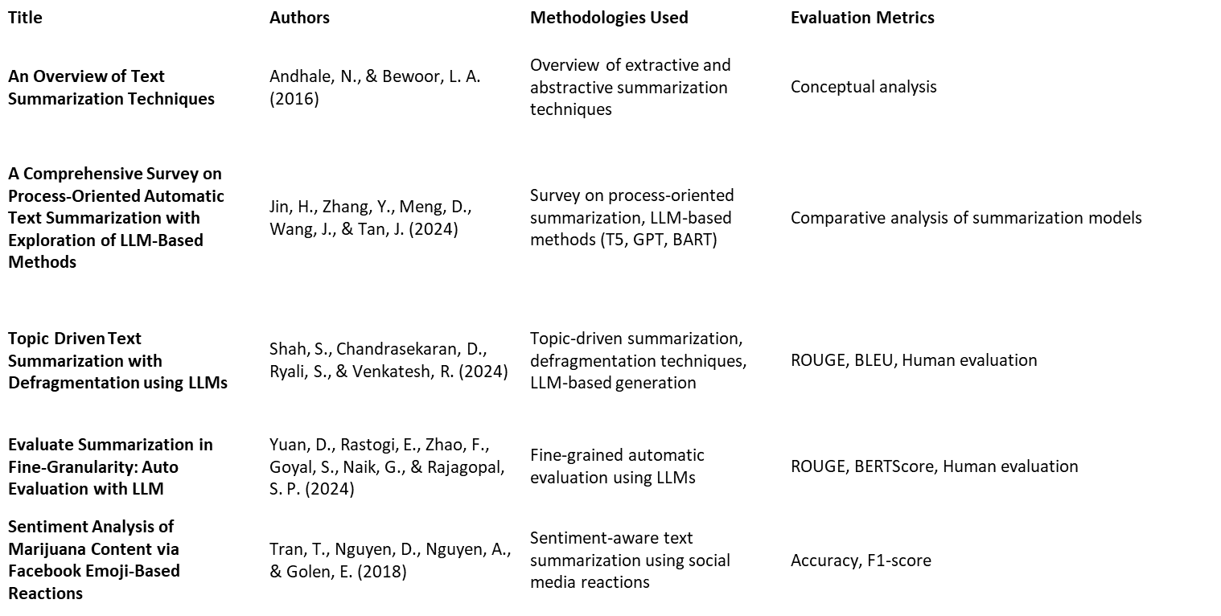
Related Work – (4-5 papers)

Slide 8
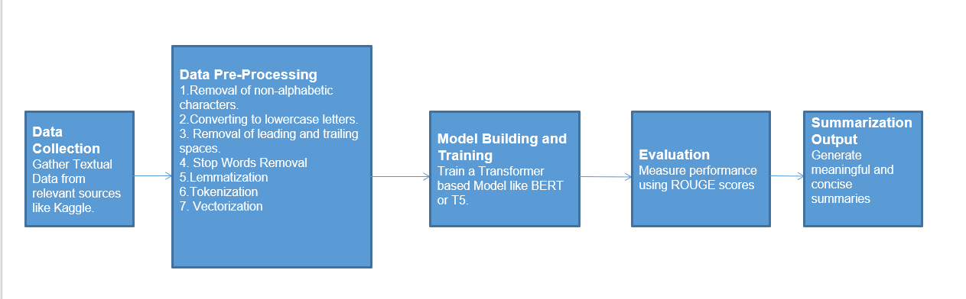
Proposed Methodology [ Max. 3 Slides ]

Slide 9
Dataset
Source of Dataset: The dataset is obtained from Kaggle. https://www.kaggle.com/datasets/varunucl/wikihow-summarization
Number of Observations:
The dataset contains around 230,000+ articles with corresponding summaries.
Column/Feature Details:
Title – The title of the wikiHow article.
Headline – A short summary or description of the article.
Text – The full content of the article.

Slide 10
Results and Discussion
Data Preprocessing
Removal of non-alphabetic characters.
Converting everything to lowercase letters.
Strip leading and trailing spaces.
Removal of stopwords like ‘is’, ’was’.
Lemmatization: Lemmatization is the process of reducing a word to
its base or root form while considering its meaning.
Tokenization: Splitting text into smaller units (tokens).
Vectorization: Converting tokens into numerical format.

Slide 11
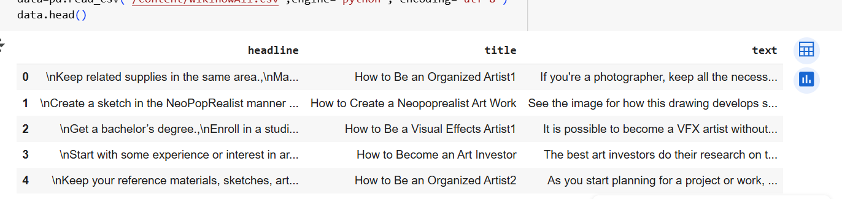
Screenshot of Dataset before Pre-processing

Slide 12
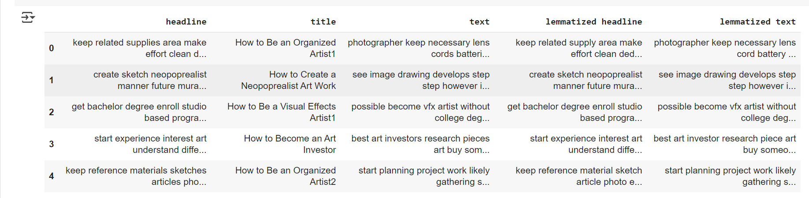
Screenshot of Dataset after preprocessing

Slide 13
Models
Three models were built for text summarization:
T5-Small (Trained on 50K Samples) - Trained on 50,000 WikiHow records.
T5-Small (Trained on 100K Samples) - Trained on 100,000 WikiHow records.
T5-Base (Pretrained, No Training with WikiHow) - A pretrained T5-Base model used without additional training.

Slide 14
Web Interface
A web-based interface was created for users to easily generate summaries using the trained models.
Developed using Gradio for a simple and interactive UI.
Features:
A textbox for users to input text.
A submit button to process the input using the trained T5 model.
A second textbox displaying the generated summary.

Slide 15
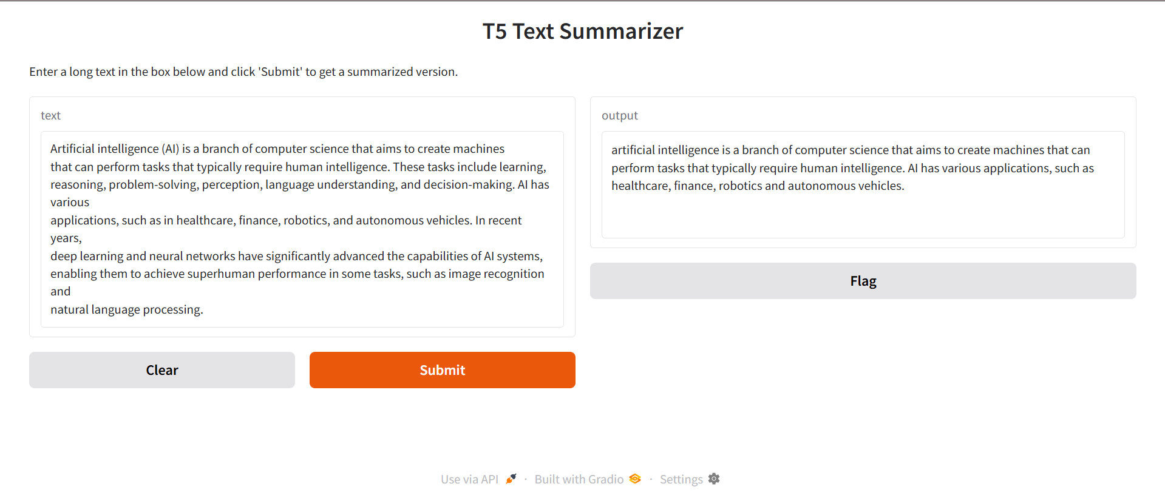
T5 small(50K)

Slide 16
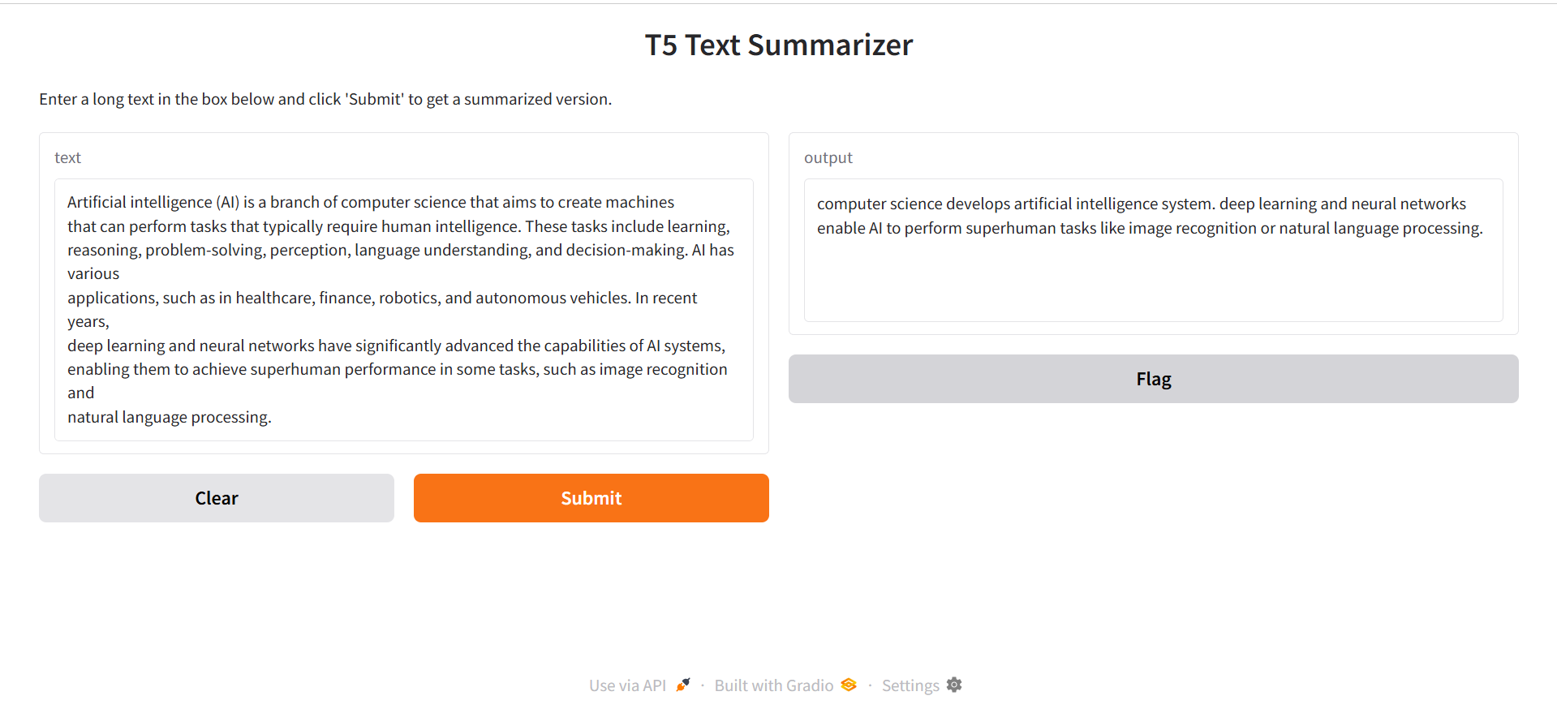
T5 small(100K)

Slide 17
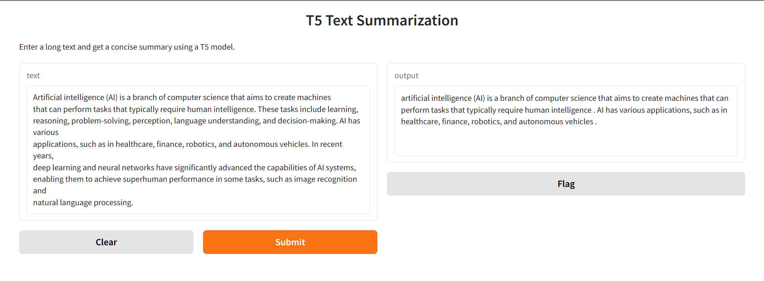
T5-Base Pretrained

Slide 18
Performance Analysis
ROUGE Score Evaluation: We used the ROUGE (Recall-Oriented Understudy for Gisting Evaluation) score to assess the quality of the generated summaries. ROUGE measures the overlap between the model-generated summary and the reference summary using:
ROUGE-1: Measures overlap of unigrams (single words).
ROUGE-2: Measures overlap of bigrams (two consecutive words).
ROUGE-L: Measures the longest common subsequence (LCS) between summaries.

Slide 19
Rouge Scores of the Three models
Model | ROUGE-1 | ROUGE-2 | ROUGE-L
T5-Base Pretrained | 0.44 | 0.27 | 0.40
T5-Small(50K) | 0.31 | 0.16 | 0.31
T5-Small(100K) | 0.38 | 0.21 | 0.38

Slide 20
Observations
T5-Base (Pretrained) achieved the highest scores across all metrics.
T5-Small (100K Samples) showed improvement over the 50K model, especially in ROUGE-1 and ROUGE-2.
T5-Small (50K Samples) had the lowest scores but was the lightest model.
Fine-tuned models still lagged behind the pretrained model in ROUGE scores.

Slide 21
Challenges
GPU Limitations in Colab – The free-tier GPU in Google Colab was insufficient for training large models for multiple epochs, restricting the performance improvements that could be achieved.
Limited Training Epochs – Due to computational constraints, the T5-Small model was trained for only a few epochs, potentially affecting its ability to learn complex patterns effectively.
Handling Large Dataset – Processing the extensive WikiHow dataset required significant memory optimization, leading to dataset reduction and careful management of system resources.
Runtime Disconnections – Frequent session timeouts and runtime disconnections in Colab disrupted the training process, requiring manual intervention and checkpointing.

Slide 22
Conclusion
This project aimed to develop a text summarization model using transformers trained on Wikihow dataset from Kaggle.
The dataset was pre-processed and only a portion of the dataset was sampled for training the model due to GPU constraints.
A pretrained T5 base model and two T5 small models were trained on Wikihow dataset to generate summaries.
The Pre-Trained T5 base model performed better than the t5 small models trained on Wikihow data.
A Gradio-based web interface was developed for easy summarization.
It allows users to input text and generate summaries effortlessly.

Slide 23
Future Enhancement
Dataset Expansion – Incorporate diverse sources like news, research papers, and manuals for better generalization.
Advanced Models – Explore T5-Large, BART, or GPT-4 for improved fluency and coherence.
Training Optimization – Use mixed-precision, distributed learning, and dataset pruning for efficiency.
Better Evaluation – Add BERTScore, BLEU, and METEOR for improved semantic assessment.
Web UI Improvements – Enable adjustable summary length, multi-language support, and user feedback.

Slide 24
References
Andhale, N., & Bewoor, L. A. (2016, August). An overview of text summarization techniques. In 2016 international conference on computing communication control and automation (ICCUBEA) (pp. 1-7). IEEE. https://ieeexplore.ieee.org/abstract/document/7860024/
Jin, H., Zhang, Y., Meng, D., Wang, J., & Tan, J. (2024). A comprehensive survey on process-oriented automatic text summarization with exploration of llm-based methods. arXiv preprint arXiv:2403.02901. https://arxiv.org/abs/2403.02901
Shah, S., Chandrasekaran, D., Ryali, S., & Venkatesh, R. (2024). Topic Driven Text Summarization with Defragmentation using LLMs. Authorea Preprints. https://www.techrxiv.org/doi/full/10.36227/techrxiv.173834656.60621764
Yuan, D., Rastogi, E., Zhao, F., Goyal, S., Naik, G., & Rajagopal, S. P. (2024). Evaluate Summarization in Fine-Granularity: Auto Evaluation with LLM. arXiv preprint arXiv:2412.19906. https://arxiv.org/abs/2412.19906
Tran, T., Nguyen, D., Nguyen, A., & Golen, E. (2018, May). Sentiment analysis of marijuana content via Facebook emoji-based reactions. In 2018 IEEE International Conference on Communications (ICC) (pp. 1-6). IEEE.
Web References:
T5 for text summarization in 7 lines of code : https://medium.com/artificialis/t5-for-text-summarization-in-7-lines-of-code-b665c9e40771

